Slide 1
My opinion about cell phones
Basic 12 Unit 10b

Slide 2
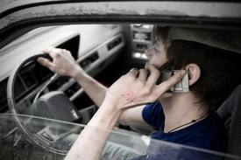
Using cell phones everywhere?

Slide 3
Brainstorm :
I think cell-pone use should be
*allowed everywhere. I should be able to make a call wherever I want to.
*banned in crowded places like trains, planes and buses.
Reason 1: These places are very small.
Reason 2: ………..
Concluding sentence: For these reasons, I think …

Slide 4
Cell Phone Use
I think cell phones should be banned in places like subways and airplanes for two important reasons. First, these places are very small and crowded. People often raise their voices when they talk on the phone. Imagine everyone talking on their phones at the same time. It is terrible and noisy. Second, ……………………………. For these reasons, I think…

Slide 5
Cell Phone Use
I think cell phones should be banned in places like subways and airplanes for two important reasons. First, these places are very small and crowded. People often raise their voices when they talk on the phone. For example, imagine everyone talking on their phones at the same time. It is terrible and noisy. Second, ………… …………………. (Here you explain your second reason and give an example) For these reasons, I think…

